Slide 1
Office 365 Value Report
Gladedager AS

Slide 2
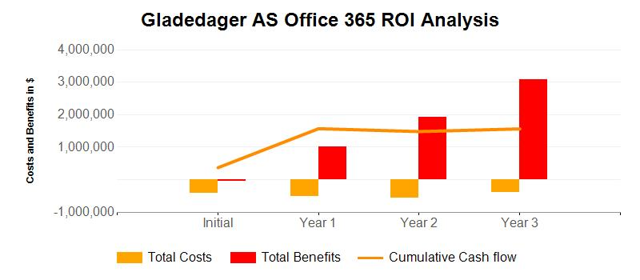
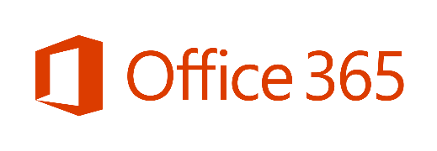
Summary of Office 365 Value
Gladedager AS
$2.588 M
in net present value over three years
For a total of 30 users.
163 %
three-year, risk-adjusted ROI
1809 %
Internal Rate of Return
$86 k
three-year, risk-adjusted NPV/User
1months
for Office 365 payback

Slide 3
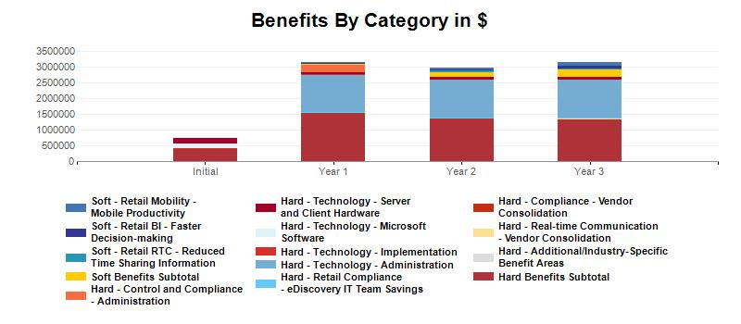
Benefit Areas
Technology
Mobility
Control & Compliance
Business Intelligence
Real-Time Communication
$4196 k
in benefits resulting from infrastructure costs, implementation efforts, licenses, and IT support
$174 k
Give mobile workers access to information and colleagues
$240 k
in labor hour savings from eliminating additional projects for implementing redundant solutions
$140 k
in production gains from better and faster access to the right information
$126 k
in benefits from better communications and eliminating redundant communication tools

Slide 4

Technology Cost Savings
$4196 k
in benefits resulting from infrastructure costs, implementation efforts, licenses, and IT support
$51 k
Implementation cost savings
$554 k
Server software, hardware, and hosting cost savings
$3592 k
IT support savings

Slide 5

Mobility
$174 k
in savings from a more productive mobile workforce

Slide 6

Compliance
$240 k
in labor hour savings from eliminating additional projects for implementing redundant solutions

Slide 7

Business Intelligence
$140 k
in production gains from better and faster access to the right information

Slide 8

Real-Time Communication
$126 k
in benefits from better communications and eliminating redundant communication tools

Slide 9
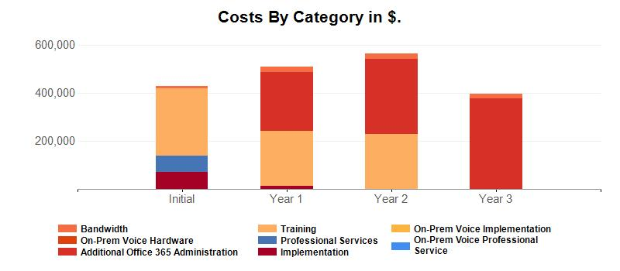
Ten Cost Categories

Slide 10
Summary of the Value of Productivity
Estimated 1 months payback for Office 365
Technology
Mobility
Control & Compliance
Business Intelligence
Real-Time Communication
Improve agility, reduce costs, and provide the tools to work efficiently
Enable employees to work from almost anywhere on any device
Help protect data and ensure compliance
Provide greater insights into business performance
Empower employees with communication tools that speed processes
$4196 k
in benefits resulting from infrastructure costs, implementation efforts, licenses, and IT support
$174 k
Give mobile workers access to information and colleagues
$240 k
in labor hour savings from eliminating additional projects for implementing redundant solutions
$140 k
in production gains from better and faster access to the right information
$126 k
in benefits from better communications and eliminating redundant communication tools

Slide 11
© 2015 Microsoft Corporation. All rights reserved. Microsoft, Windows, and other product names are or may be registered trademarks and/or trademarks in the U.S. and/or other countries.
The information herein is for informational purposes only and represents the current view of Microsoft Corporation as of the date of this presentation. Although great care has been taken to ensure the accuracy and completeness of results derived from this tool, this tool should be used for informational purposes only, and Microsoft makes no warranties, express, implied or statutory, as to the information generated by the tool or any organization's achievement of the potential benefits estimated by using Microsoft solutions or products. MICROSOFT MAKES NO WARRANTIES, EXPRESS, IMPLIED OR STATUTORY, AS TO THE INFORMATION IN THIS PRESENTATION.

